Slide 1
Chapter 10 – The Analysis of Variance

Slide 2
Outline
Single-Factor ANOVA
Multiple Comparisons in ANOVA
More on Single-Factor ANOVA

Slide 3
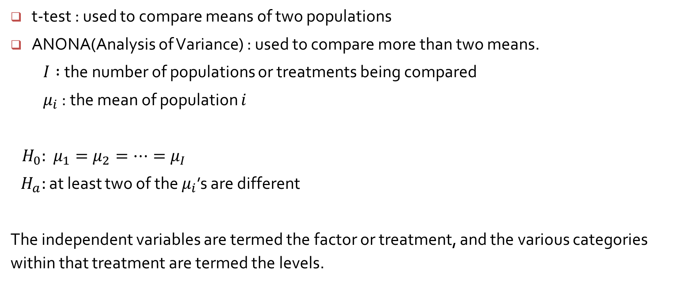
10.1 Single Factor ANOVA
t-test : used to compare means of two populations
ANONA(Analysis of Variance) : used to compare more than two means.
$I :$the number of populations or treatments being compared
$μ_{i}$ : the mean of population $i$
$H_{0}:$ $μ_{1}=μ_{2}=⋯{=μ}_{I}$
$H_{a}:$ at least two of the $μ_{i}$’s are different
The independent variables are termed the factor or treatment, and the various categories within that treatment are termed the levels.

Slide 4
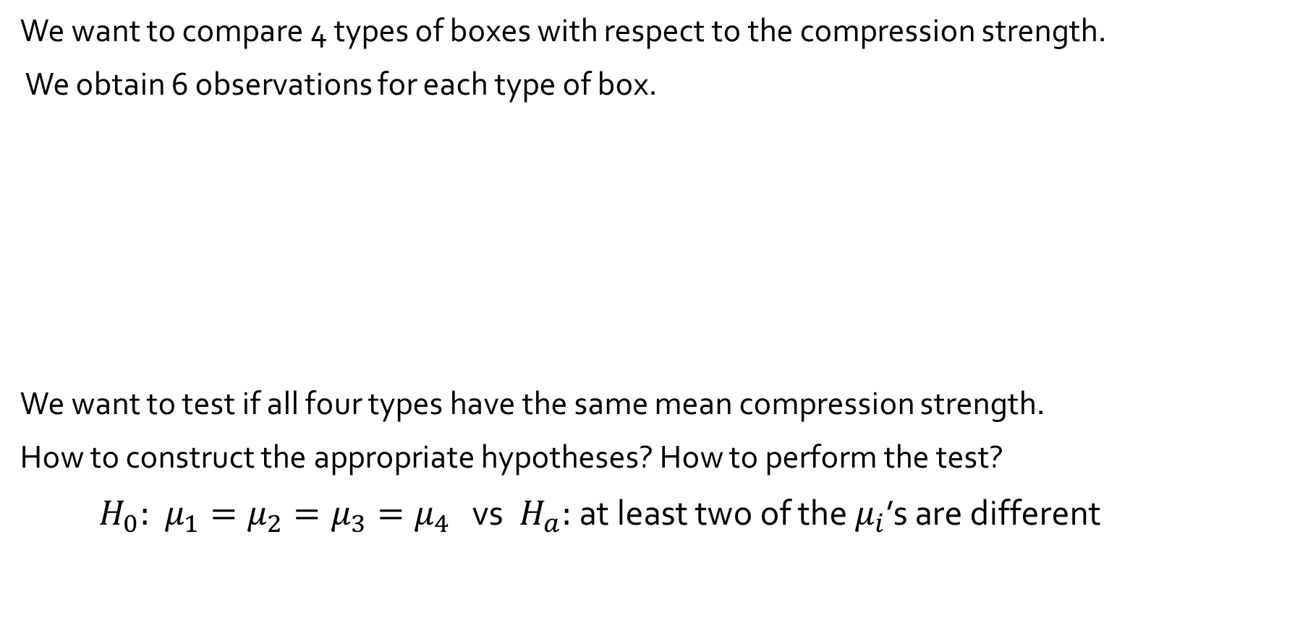
10.1 Single Factor ANOVA Example 10.1
We want to compare 4 types of boxes with respect to the compression strength.
We obtain 6 observations for each type of box.
We want to test if all four types have the same mean compression strength.
How to construct the appropriate hypotheses? How to perform the test?
$H_{0}:$ $μ_{1}=μ_{2}=μ_{3}=μ_{4}$ vs $H_{a}:$ at least two of the $μ_{i}$’s are different
Type of Box | Compression Strength (lb) | Sample Mean | Sample SD
1 2 3 4 | 655.5 788.3 734.3 721.4 679.1 699.4 789.2 772.5 786.9 686.1 732.1 774.8 737.1 639.0 696.3 671.7 717.2 727.1 535.1 628.7 542.4 559.0 586.9 520.0 Grand mean = | 713.00 756.93 698.07 562.02 682.50 | 46.55 40.34 37.20 39.87

Slide 5
11.1 Two Factor ANOVA Example 11.1
Compare three different brands of erasable pens and four different wash treatments with respect to their ability to remove marks on a fabric.
The data shows the overall specimen color change; the lower this value, the more marks were removed.
 | Washing Treatment | Total Average
 | 1 2 3 4
1 Brand of Pen 2 3 | 0.97 0.48 0.48 0.46 0.77 0.14 0.22 0.25 0.67 0.39 0.57 0.19 | 2.39 0.598 1.38 0.345 1.82 0.455
Total Average | 2.41 1.01 1.27 0.90 0.803 0.337 0.423 0.300 | Grand average : 0.466

Slide 6
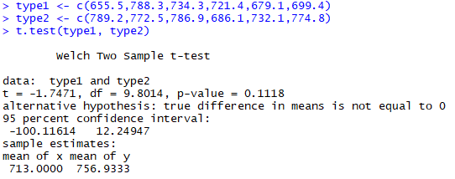

10.1 Single Factor ANOVA Example 10.1
Suppose that we want to test if first and second type of box have the same mean compression strength.
$H_{0}:$ $μ_{1}−μ_{2}=0$ vs $H_{a}:$ $μ_{1}−μ_{2}≠0$
Since p-value=0.1118 > 0.05, we do not reject $H_{0}$. We do not have enough evidence to say that the means of the first and second type of box are different.

Slide 7
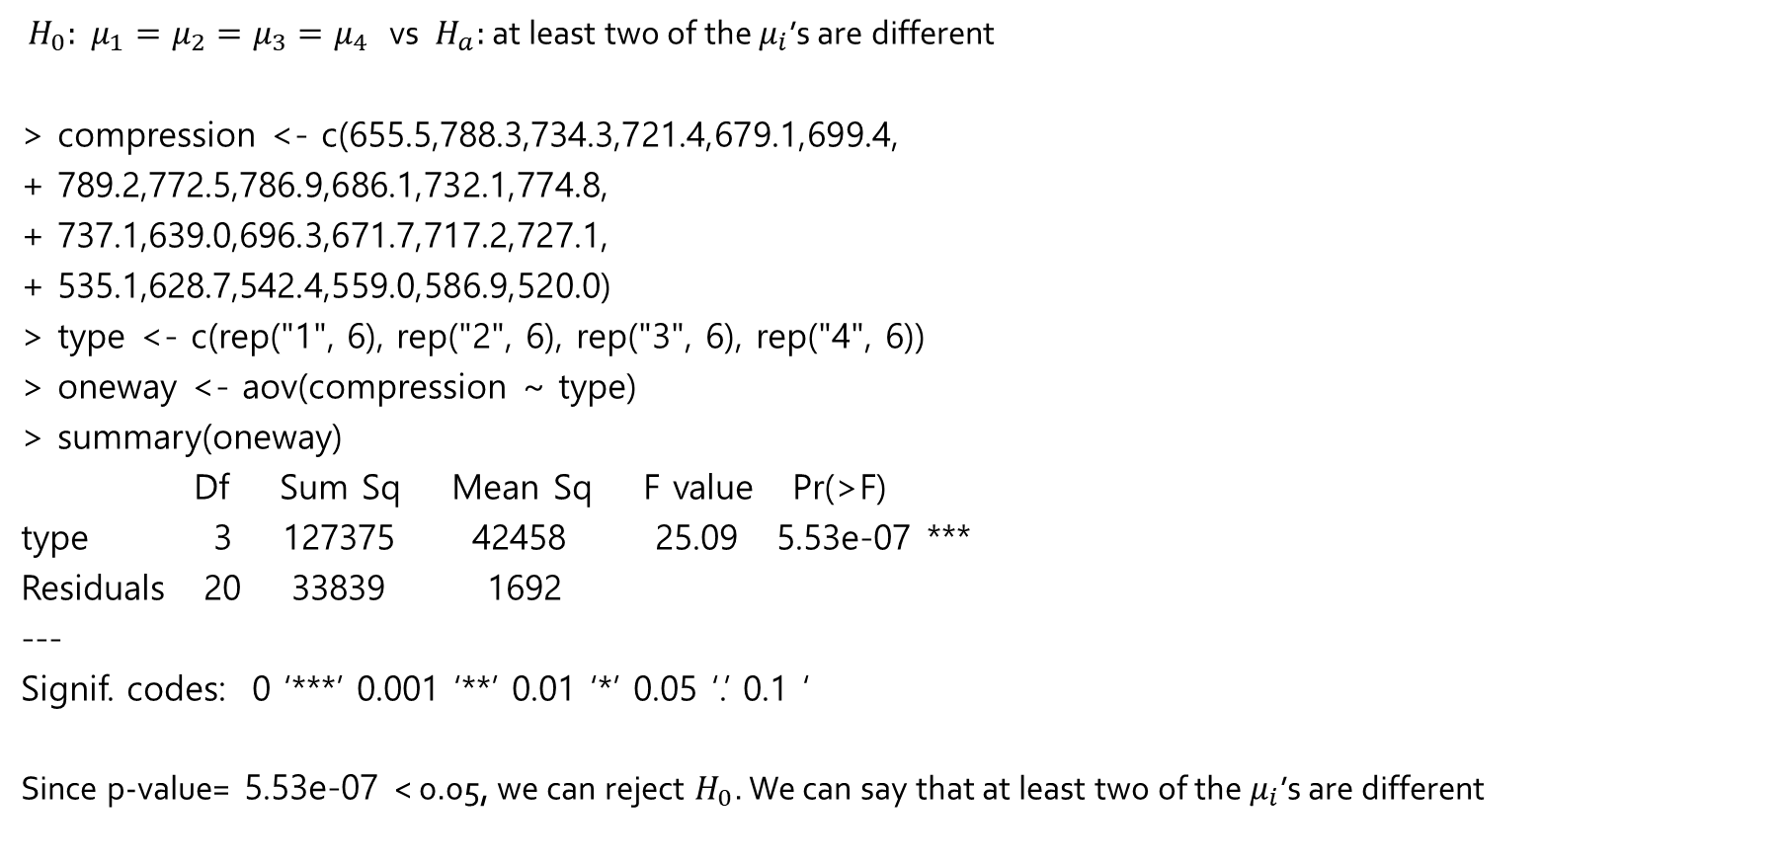
R execution of Example 10.1
$H_{0}:$ $μ_{1}=μ_{2}=μ_{3}=μ_{4}$ vs $H_{a}:$ at least two of the $μ_{i}$’s are different
> compression <- c(655.5,788.3,734.3,721.4,679.1,699.4,
+ 789.2,772.5,786.9,686.1,732.1,774.8,
+ 737.1,639.0,696.3,671.7,717.2,727.1,
+ 535.1,628.7,542.4,559.0,586.9,520.0)
> type <- c(rep("1", 6), rep("2", 6), rep("3", 6), rep("4", 6))
> oneway <- aov(compression ~ type)
> summary(oneway)
Df Sum Sq Mean Sq F value Pr(>F)
type 3 127375 42458 25.09 5.53e-07 ***
Residuals 20 33839 1692
---
Signif. codes: 0 ‘***’ 0.001 ‘**’ 0.01 ‘*’ 0.05 ‘.’ 0.1 ‘
Since p-value= 5.53e-07 < 0.05, we can reject $H_{0}$. We can say that at least two of the $μ_{i}$’s are different

Slide 8
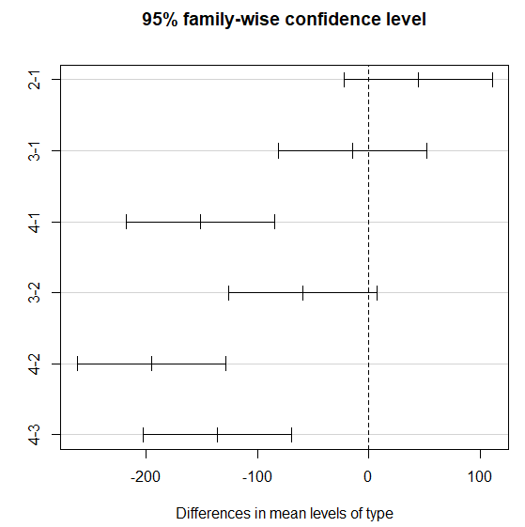
> posthoc <- TukeyHSD(x=oneway, 'type', conf.level=0.95)
> posthoc
> plot(posthoc)

Slide 9
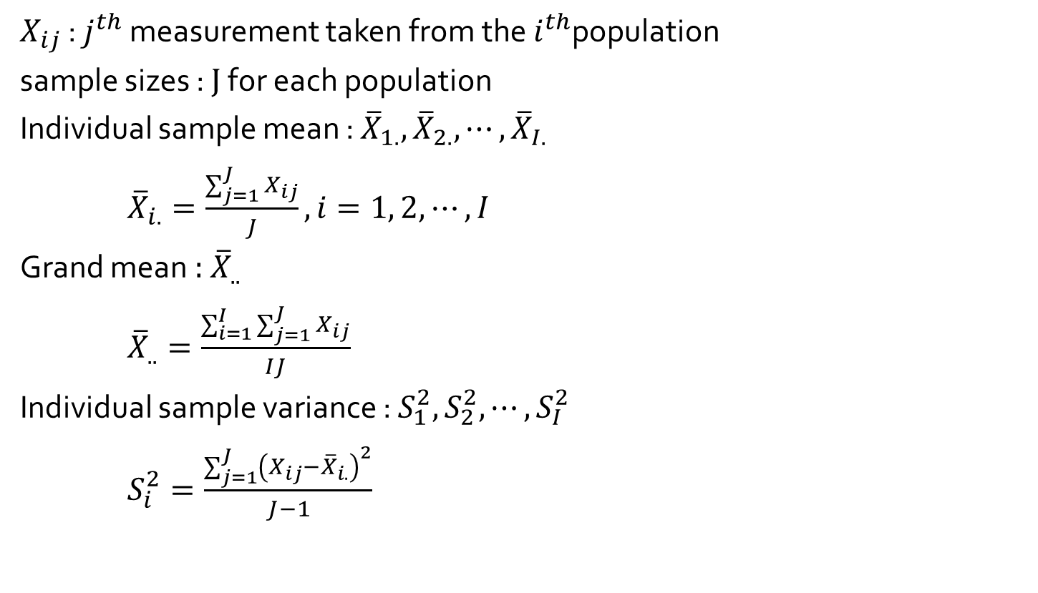
ANOVA: notation (equal sample size)
$X_{ij}$ : $j^{th}$ measurement taken from the $i^{th}$population
sample sizes : $J$ for each population
Individual sample mean : ${\overline{X}}_{1.},$ ${\overline{X}}_{2.}, ⋯, {\overline{X}}_{I.}$
${\overline{X}}_{i.}=\frac{\sum_{j=1}^{J}{X_{ij}}}{J}, i=1, 2, ⋯, I$
Grand mean : ${\overline{X}}_{..}$
${\overline{X}}_{..}=\frac{\sum_{i=1}^{I}{\sum_{j=1}^{J}{X_{ij}}}}{IJ}$
Individual sample variance : $S_{1}^{2},S_{2}^{2},{⋯,S}_{I}^{2}$
$S_{i}^{2}=\frac{\sum_{j=1}^{J}{{\left(X_{ij}−{\overline{X}}_{i.}\right)}^{2}}}{J−1}$

Slide 10
10.1 Single Factor ANOVA Example 10.1
We want to compare 4 types of boxes with respect to the compression strength.
We obtain 6 observations for each type of box.
We want to test if all four types have the same mean compression strength.
How to construct the appropriate hypotheses? How to perform the test?
$H_{0}:$ $μ_{1}=μ_{2}=μ_{3}=μ_{4}$ vs $H_{a}:$ at least two of the $μ_{i}$’s are different
Type of Box | Compression Strength (lb) | Sample Mean | Sample SD
1 2 3 4 | 655.5 788.3 734.3 721.4 679.1 699.4 789.2 772.5 786.9 686.1 732.1 774.8 737.1 639.0 696.3 671.7 717.2 727.1 535.1 628.7 542.4 559.0 586.9 520.0 Grand mean = | 713.00 756.93 698.07 562.02 682.50 | 46.55 40.34 37.20 39.87

Slide 11

ANOVA
Assumption
All samples are independent of each other.
Each population or treatment distributions are normal with E($X_{ij}$) = $μ_{i}$.
Each population has the same variance Var($X_{ij}$) = σ².

Slide 12
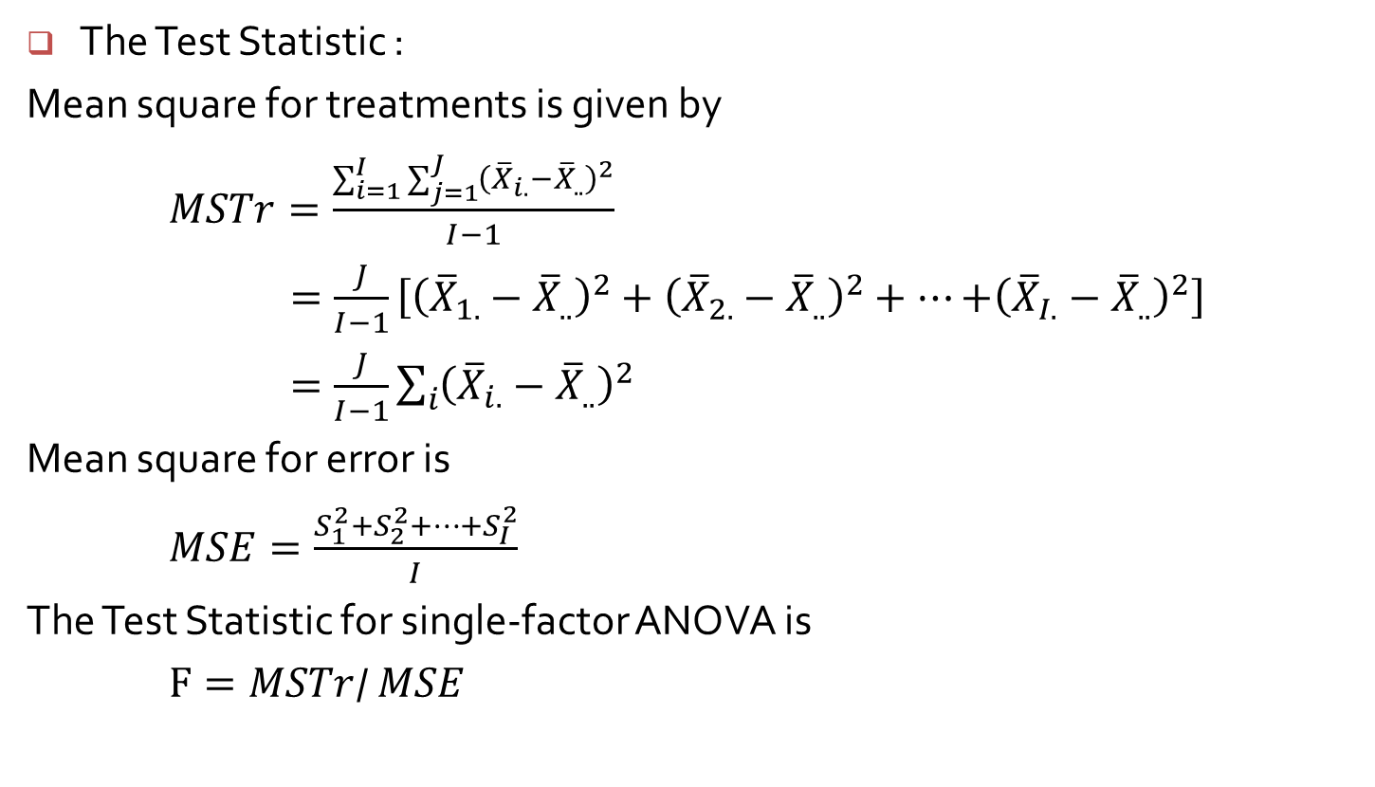
ANOVA
The Test Statistic :
Mean square for treatments is given by
$MSTr=\frac{\sum_{i=1}^{I}{\sum_{j=1}^{J}{{\left({\overline{X}}_{i.}−{\overline{X}}_{..}\right)}^{2}}}}{I−1}$
$=\frac{J}{I−1}\left[{\left({\overline{X}}_{1.}−{\overline{X}}_{..}\right)}^{2}+{\left({\overline{X}}_{2.}−{\overline{X}}_{..}\right)}^{2}+⋯{+\left({\overline{X}}_{I.}−{\overline{X}}_{..}\right)}^{2}\right]$
$=\frac{J}{I−1}\sum_{i}{{\left({\overline{X}}_{i.}−{\overline{X}}_{..}\right)}^{2}}$
Mean square for error is
$MSE=\frac{S_{1}^{2}+S_{2}^{2}+⋯+S_{I}^{2}}{I}$
The Test Statistic for single-factor ANOVA is
$F=MSTr$/ $MSE$

Slide 13
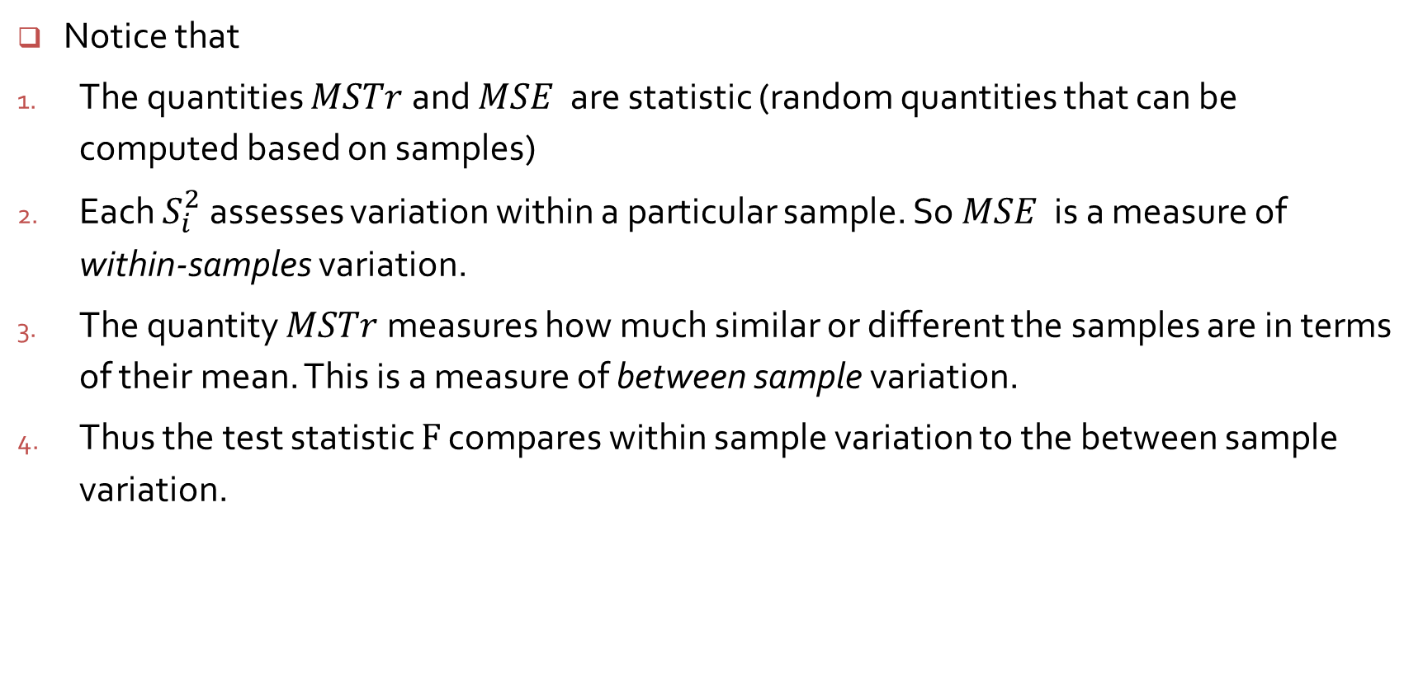
ANOVA
Notice that
The quantities $MSTr$ and $MSE$ are statistic (random quantities that can be computed based on samples)
Each $S_{i}^{2}$ assesses variation within a particular sample. So $MSE$ is a measure of within-samples variation.
The quantity $MSTr$ measures how much similar or different the samples are in terms of their mean. This is a measure of between sample variation.
Thus the test statistic $F$ compares within sample variation to the between sample variation.

Slide 14
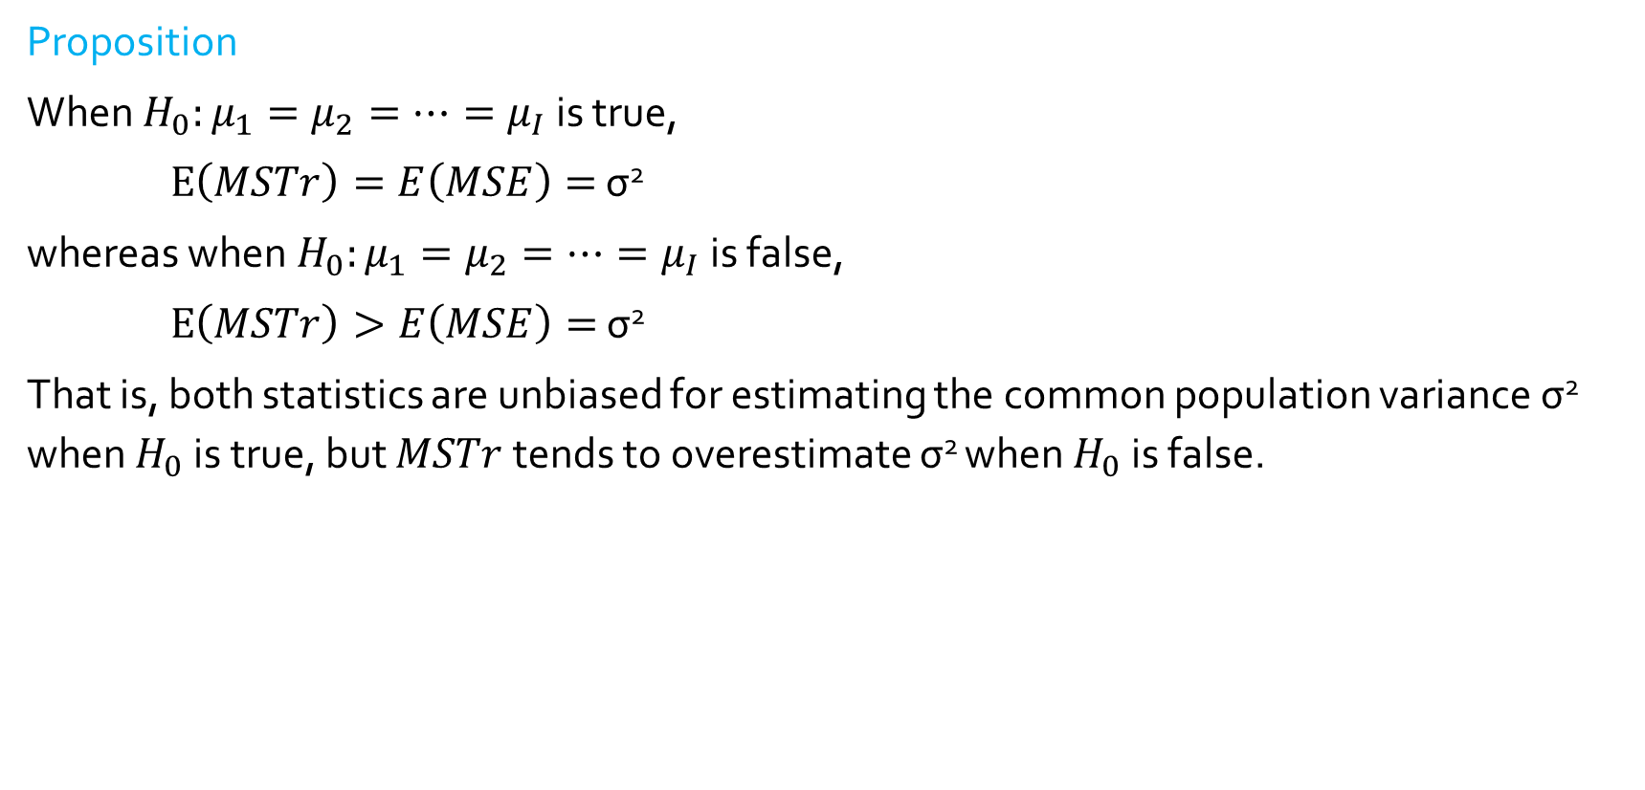
ANOVA
Proposition
When $H_{0}:μ_{1}=μ_{2}=⋯{=μ}_{I}$ is true,
$E\left(MSTr\right)=E\left(MSE\right)=$ σ²
whereas when $H_{0}:μ_{1}=μ_{2}=⋯{=μ}_{I}$ is false,
$E\left(MSTr\right)>E\left(MSE\right)=$ σ²
That is, both statistics are unbiased for estimating the common population variance σ² when $H_{0}$ is true, but $MSTr$ tends to overestimate σ² when $H_{0}$ is false.

Slide 15
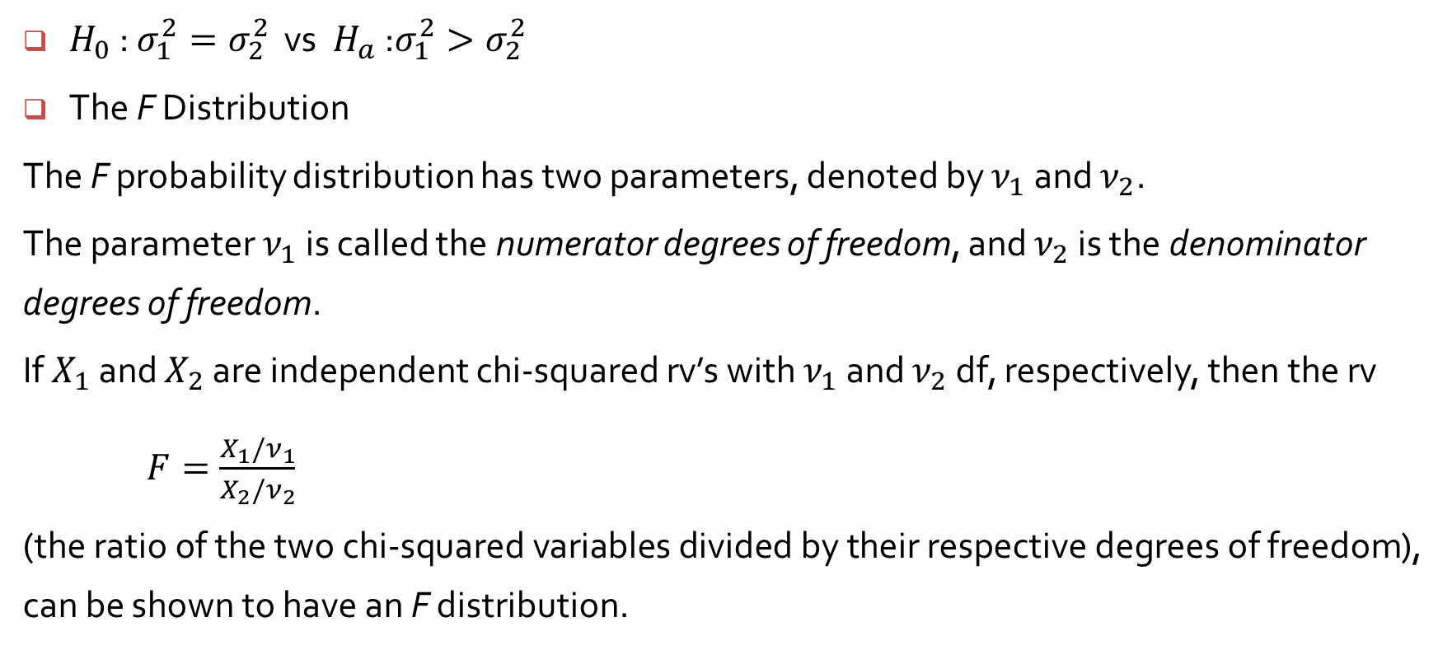
Inference Concerning Two Population Variances
$H_{0}$ : $σ_{1}^{2}=σ_{2}^{2}$ vs ${ H}_{a}$ :$σ_{1}^{2}>σ_{2}^{2}$
The F Distribution
The F probability distribution has two parameters, denoted by $ν_{1}$ and $ν_{2}$.
The parameter $ν_{1}$ is called the numerator degrees of freedom, and $ν_{2}$ is the denominator degrees of freedom.
If $X_{1}$ and $X_{2}$ are independent chi-squared rv’s with $ν_{1}$ and $ν_{2}$ df, respectively, then the rv
$F=\frac{X_{1}/ν_{1}}{X_{2}/ν_{2}}$
(the ratio of the two chi-squared variables divided by their respective degrees of freedom), can be shown to have an F distribution.

